Slide 1

Emprendemos
3/Junio/2023
Magister Eduard Duarte Sepúlveda

Slide 2
Temas
Que vamos a encontrar
Daily
HTTP
REST
Conceptos
Verbos
Arquitectura
Cloud
AWS
ApiGateway
Cognito
Dedicación al curos

Slide 3
Hypertext Transfer Protocol (HTTP)
Entregando Valor
A communications protocol
Allows retrieving inter-linked text documents (hypertext)
World Wide Web.
HTTP Verbs
HEAD
GET
POST
PUT
DELETE
TRACE
OPTIONS
CONNECT
GET /index.html HTTP/1.1
Host: www.uniandes.edu.co
Browser
Web Server
HTTP/1.1 200 OK
Content-Type: text/html
<html><head>…

Slide 4
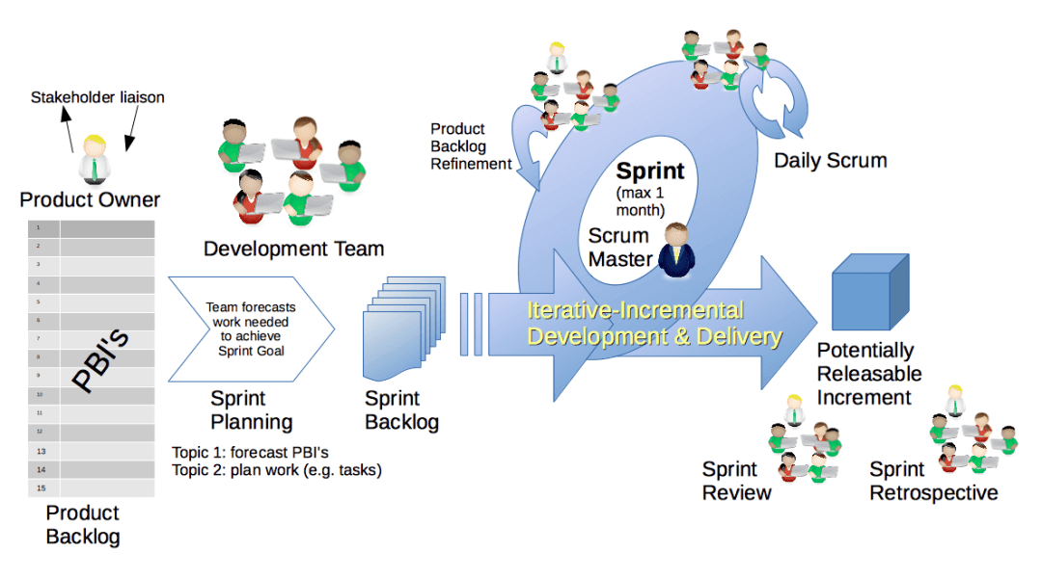
Daily
Entregando Valor

Slide 5
Representational State Transfer (REST)
Entregando Valor
A style of software architecture for distributed hypermedia systems such as the World Wide Web.
Introduced in the doctoral dissertation of Roy Fielding
One of the principal authors of the HTTP specification.
A collection of network architecture principles which outline how resources are defined and addressed

Slide 6
REST and HTTP
Entregando Valor
The motivation for REST was to capture the characteristics of the Web which made the Web successful.
URI Addressable resources
HTTP Protocol
Make a Request – Receive Response – Display Response
Exploits the use of the HTTP protocol beyond HTTP POST and HTTP GET
HTTP PUT, HTTP DELETE

Slide 7
REST - not a Standard
REST is not a standard
JSR 311: JAX-RS: The JavaTM API for RESTful Web Services
But it uses several standards:
HTTP
URL
XML/HTML/GIF/JPEG/etc (Resource Representations)
text/xml, text/html, image/gif, image/jpeg, etc (Resource Types, MIME Types)
Entregando Valor

Slide 8
Main Concepts
Entregando Valor
Nouns (Resources) unconstrained i.e., http://example.com/employees/12345
REST
Verbs constrained i.e., GET
Representations constrained i.e., XML

Slide 9
Verbs
Entregando Valor
Represent the actions to be performed on resources
HTTP GET
HTTP POST
HTTP PUT
HTTP DELETE

Slide 10
HTTP GET
Entregando Valor
How clients ask for the information they seek.
Issuing a GET request transfers the data from the server to the client in some representation
GET http://localhost/books
Retrieve all books
GET http://localhost/books/ISBN-0011021
Retrieve book identified with ISBN-0011021
GET http://localhost/books/ISBN-0011021/authors
Retrieve authors for book identified with ISBN-0011021

Slide 11
HTTP DELETE
Entregando Valor
Removes the resource identified by the URI
DELETE http://localhost/books/ISBN-0011
Delete book identified by ISBN-0011

Slide 12
Representations
Entregando Valor
How data is represented or returned to the client for presentation.
Two main formats:
JavaScript Object Notation (JSON)
XML
It is common to have multiple representations of the same data

Slide 13
Representations
Entregando Valor
XML
<COURSE>
<ID>CS2650</ID>
<NAME>Distributed Multimedia Software</NAME>
</COURSE>
JSON
{course
{id: CS2650}
{name: Distributed Multimedia Sofware}
}

Slide 14
Why is it called "Representational State Transfer"?
Entregando Valor
Resource
Client
http://www.boeing.com/aircraft/747
Fuel requirements
Maintenance schedule
...
Boeing747.html
The Client references a Web resource using a URL. A representation of the resource is returned (in this case as an HTML document).
The representation (e.g., Boeing747.html) places the client application in a state. The result of the client traversing a hyperlink in Boeing747.html is another resource accessed. The new representation places the client application into yet another state. Thus, the client application changes (transfers) state with each resource representation --> Representation State Transfer!

Slide 15
Architecture Style
Entregando Valor
Request
(XML doc)
HTTP GET
URL 1
doGet()
Response
(XML doc)
HTTP Response
doPost(id)
Request
(XML doc)
HTTP POST
URL 1
REST Engine
(locate resource and generate response)
Web/Proxy Server
Response
(JSON doc)
HTTP Response
doDelete()
PO
(XML doc)
HTTP DELETE
URL 1
Response
(TEXT doc)
HTTP Response

Slide 16
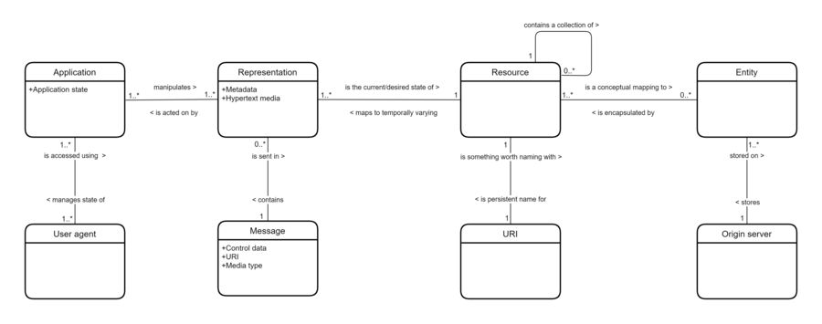
Architecture Style
Entregando Valor
Representational state transfer - Wikipedia

Slide 17
Real Life Examples
Entregando Valor
Google Maps
Google AJAX Search API
Yahoo Search API
Amazon WebServices

Slide 18
REST and the Web
Entregando Valor
The Web is an example of a REST system!
All of those Web services that you have been using all these many years - book ordering services, search services, online dictionary services, etc - are REST-based Web services.
Alas, you have been using REST, building REST services and you didn't even know it.

Slide 19
Que aprenderemos – Entregando Valor
Entregar Valor de negocio
Preparación técnica
Inteligencia Artificial
Cloud Computing
Block Chain
NFTs
Metaverso

Slide 20
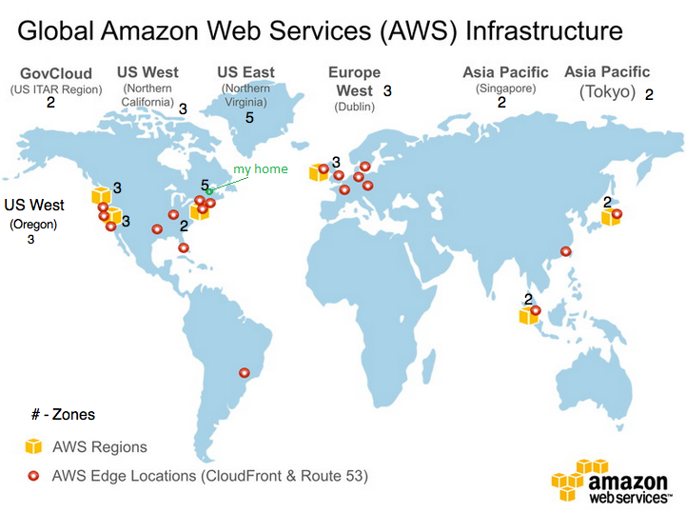
AWS – Cloud
Entregando Valor

Slide 21
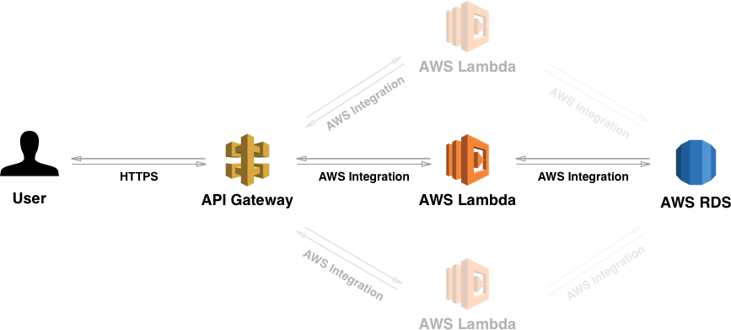
APIs AWS
Entregando Valor

Slide 22
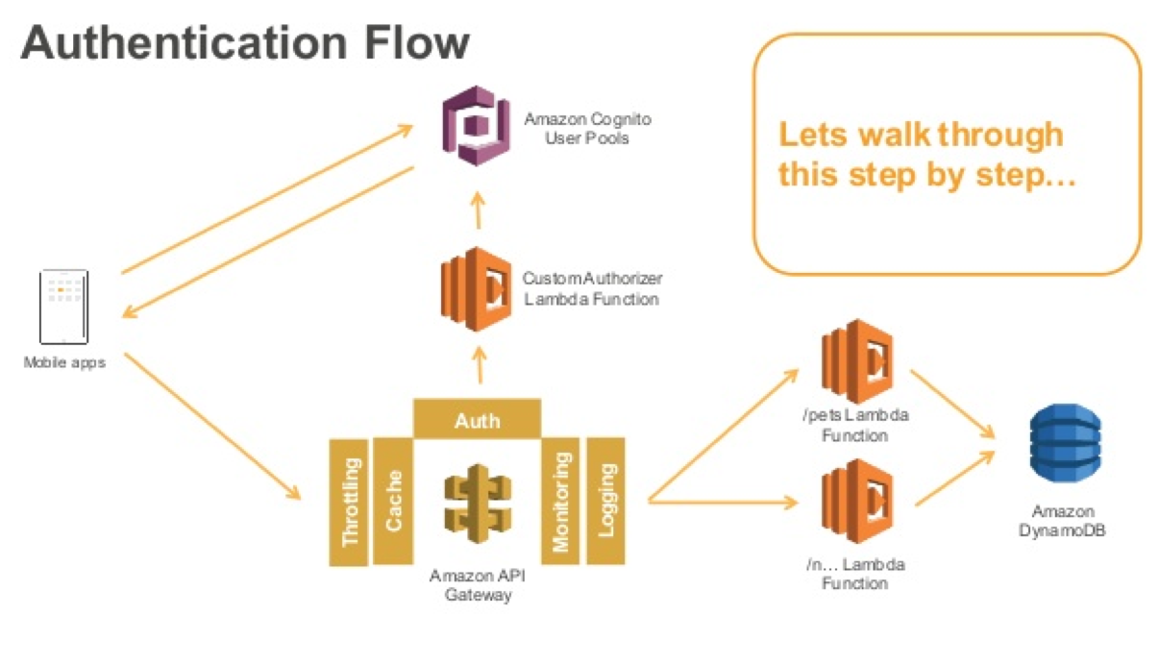
AWS Cognito - Authentication
Entregando Valor

Slide 23
Cuánto Durará
Horas de trabajo
4 Créditos
4 horas de clase
12 horas de desarrollo
3 semestres
2 vacacionales
Preparación
lectura
trabajo
Participación
Atención
Preguntas
Cierre
Trabajo
Propuestas

Slide 24
Beneficios
Motivación
Académico
Nivel Postgrado
Preparación
Laboral
Hoja de Vida - Experiencia
Certificaciones
Económicas
Becas
Acciones – Stoks

Slide 25

Muchas Gracias
Notes:
Cultura y velocidad distinta….
Plantear argumentos

